Slide 1
CS 4530
Software Engineering
Lecture 12 - Debugging II + Code Review
Jonathan Bell, John Boyland, Mitch Wand
Khoury College of Computer Sciences

Slide 2

Zoom Mechanics
Recording: This meeting is being recorded
If you feel comfortable having your camera on, please do so! If not: a photo?
I can see the zoom chat while lecturing, slack while you’re in breakout rooms
If you have a question or comment, please either:
“Raise hand” - I will call on you
Write “Q: <my question>” in chat - I will answer your question, and might mention your name and ask you a follow-up to make sure your question is addressed
Write “SQ: <my question>” in chat - I will answer your question, and not mention your name or expect you to respond verbally

Slide 3
Today’s Agenda
Administrative:
HW3 due tomorrow!
Today’s session:
Debugging
Code Review
Notes:
Reminders of async/await gotchas, expecting an exception, hard-coding error message in that too

Slide 4
What are your pro debugging strategies?
Notes:
Discussion/reflection: What were the most difficult debugging scenarios you have encountered at NEU or working?
Other struggles: Capturing enough details to reproduce bug (e.g. steps to reproduce, stack trace, core dump, more invasive logging)
See example from activity… who struggled? Logging is extremely valuable.
Minimally reproduce it FASTER (mvn test… mvn -Dtest=myTest test… mvn -Dmaven.javadoc.skip -Dtest=myTest test…)
Assume documentation stinks
Use a debugger [Including React dev tools]
Use an analysis tool when possible - debugger, valgrind, race detector, hsdb,
Write a test

Slide 5
Domain-specific debugging
Valgrind: C/C++ Memory Errors
$ valgrind ./main
==8515== Memcheck, a memory error detector
==8515== Copyright (C) 2002-2015, and GNU GPL'd, by Julian Seward et al.
==8515== Using Valgrind-3.11.0 and LibVEX; rerun with -h for copyright info
==8515== Command: ./main
==8515==
==8515== Conditional jump or move depends on uninitialised value(s)
==8515== at 0x400813: fail() (main.cpp:7)
==8515== by 0x40083F: main (main.cpp:13)
==8515==
==8515== Invalid read of size 4
==8515== at 0x400819: fail() (main.cpp:8)
==8515== by 0x40083F: main (main.cpp:13)
==8515== Address 0x0 is not stack'd, malloc'd or (recently) free'd
==8515==
==8515==
==8515== Process terminating with default action of signal 11 (SIGSEGV): dumping core
==8515== Access not within mapped region at address 0x0
==8515== at 0x400819: fail() (main.cpp:8)
==8515== by 0x40083F: main (main.cpp:13)
==8515== If you believe this happened as a result of a stack
==8515== overflow in your program's main thread (unlikely but
==8515== possible), you can try to increase the size of the
==8515== main thread stack using the --main-stacksize= flag.
==8515== The main thread stack size used in this run was 8388608.
==8515==
==8515== HEAP SUMMARY:
==8515== in use at exit: 72,704 bytes in 1 blocks
==8515== total heap usage: 1 allocs, 0 frees, 72,704 bytes allocated
==8515==
==8515== LEAK SUMMARY:
==8515== definitely lost: 0 bytes in 0 blocks
==8515== indirectly lost: 0 bytes in 0 blocks
==8515== possibly lost: 0 bytes in 0 blocks
==8515== still reachable: 72,704 bytes in 1 blocks
==8515== suppressed: 0 bytes in 0 blocks
==8515== Rerun with --leak-check=full to see details of leaked memory
==8515==
==8515== For counts of detected and suppressed errors, rerun with: -v
==8515== Use --track-origins=yes to see where uninitialised values come from
==8515== ERROR SUMMARY: 2 errors from 2 contexts (suppressed: 0 from 0)
$ ./main
Segmentation fault (core dumped)
https://www.valgrind.org/info/tools.html

Slide 6
Domain-specific debugging
TSan: Data race detector for C/C++/Go
$ cat simple_race.cc
#include <pthread.h>
#include <stdio.h>
int Global;
void *Thread1(void *x) {
Global++;
return NULL;
}
void *Thread2(void *x) {
Global--;
return NULL;
}
int main() {
pthread_t t[2];
pthread_create(&t[0], NULL, Thread1, NULL);
pthread_create(&t[1], NULL, Thread2, NULL);
pthread_join(t[0], NULL);
pthread_join(t[1], NULL);
}
$ clang++ simple_race.cc -fsanitize=thread -fPIE -pie -g
$ ./a.out
==================
WARNING: ThreadSanitizer: data race (pid=26327)
Write of size 4 at 0x7f89554701d0 by thread T1:
#0 Thread1(void*) simple_race.cc:8 (exe+0x000000006e66)
Previous write of size 4 at 0x7f89554701d0 by thread T2:
#0 Thread2(void*) simple_race.cc:13 (exe+0x000000006ed6)
Thread T1 (tid=26328, running) created at:
#0 pthread_create tsan_interceptors.cc:683 (exe+0x00000001108b)
#1 main simple_race.cc:19 (exe+0x000000006f39)
Thread T2 (tid=26329, running) created at:
#0 pthread_create tsan_interceptors.cc:683 (exe+0x00000001108b)
#1 main simple_race.cc:20 (exe+0x000000006f63)
==================
ThreadSanitizer: reported 1 warnings
https://github.com/google/sanitizers/wiki/ThreadSanitizerCppManual

Slide 7
Domain-specific debugging
RVPredict: Data race detector (Java)
package examples;
public class SimpleRace {
static int sharedVar;
public static void main(String[] args) {
new ThreadRunner() {
@Override
public void thread1() {
sharedVar++;
}
@Override
public void thread2() {
sharedVar++;
}
};
}
}
Data race on field examples.SimpleRace.sharedVar: {{{
Concurrent write in thread T10 (locks held: {})
----> at examples.SimpleRace$1.thread1(SimpleRace.java:11)
at examples.ThreadRunner$1.run(ThreadRunner.java:17)
T10 is created by T1
at examples.ThreadRunner.<init>(ThreadRunner.java:26)
Concurrent read in thread T11 (locks held: {})
----> at examples.SimpleRace$1.thread2(SimpleRace.java:16)
at examples.ThreadRunner$2.run(ThreadRunner.java:23)
T11 is created by T1
at examples.ThreadRunner.<init>(ThreadRunner.java:27)
}}}
https://runtimeverification.com/blog/detecting-popular-data-races-in-java-using-rv-predict/

Slide 8
Domain-specific debugging
React Developer Tools
https://chrome.google.com/webstore/detail/react-developer-tools/fmkadmapgofadopljbjfkapdkoienihi?hl=en

Slide 9
Activity: Debugging (Continued)
https://neu-se.github.io/CS4530-CS5500-Spring-2021/Activities/activity7-1
Notes:
Find the activity writeup here: https://neu-se.github.io/CS4530-CS5500-Spring-2021/Activities/activity7-1
Q: (Check) - Does sessions cleanup bug get caught by tests? A: Yes, by
“when a socket disconnect event is fired” -> “should destroy the session corresponding to that socket”
(Should be yes? Right?)
Q: What about the last bug that we didn’t discuss: that more than 5 people can connect to a room.
1. Can we reproduce it?
2. Brainstorm hypotheses as to why this happens
Investigate together:
* Is there any code in backend to prevent this?
* No
* How to prevent?

Slide 10
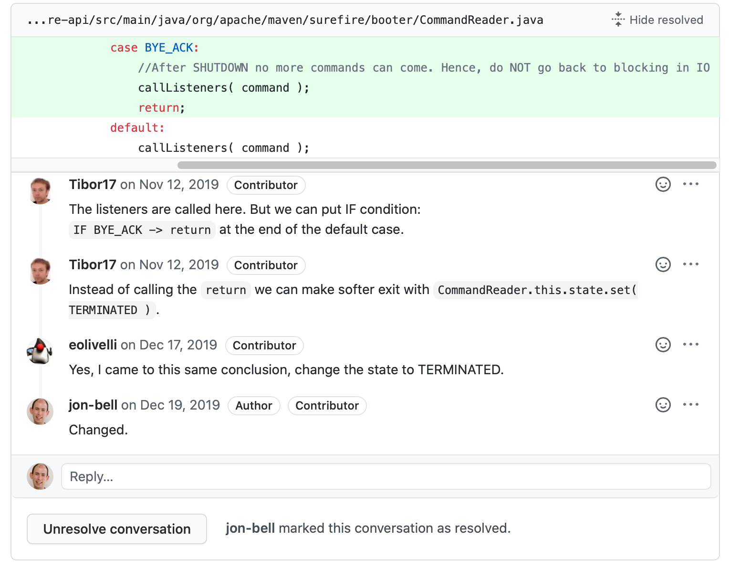
What are code reviews?

Slide 11
Linus’ Law
“Many eyes make all bugs shallow”
public disconnect(session : PlayerSession) : void {
console.log(`Disconnect: ${session.sessionToken}`);
this._sessions = this._sessions.filter(s => s === session);
this._listeners.map((l) => l.onPlayerDisconnected(session.player));
}

Slide 12
Formal “Code Inspections”
The origins of Code Reviews
Formal process for reading through code as a group
Applied to all project documents
3-5 person team reads the code aloud and explains what is being done
Generally a 60 minute meeting
Less efficient (defects/cost) than modern review processes

Slide 13
Why do we perform code reviews?
Survey internal to Google
Original motivation: “force developers to write code that other developers could understand”
Three key benefits found:
Ensure consistent style/design standards followed
Ensure adequate tests
Provides a security control (gatekeeping, especially for critical code)
“Modern Code Review: A Case Study at Google”, Sadowski et al, ICSE 2018

Slide 14
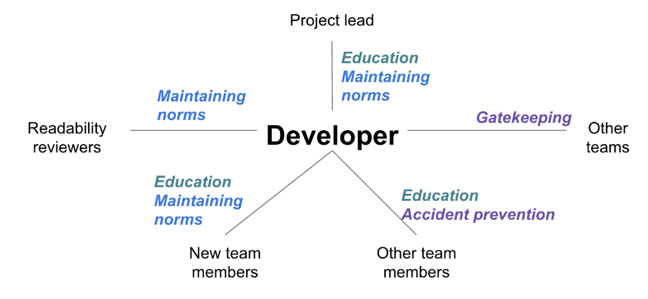
Why do we perform code reviews?
Different team members have different motivations
“Modern Code Review: A Case Study at Google”, Sadowski et al, ICSE 2018
Notes:
Original motivation: “force developers to write code that other developers could understand”
Three key benefits found:

Slide 15
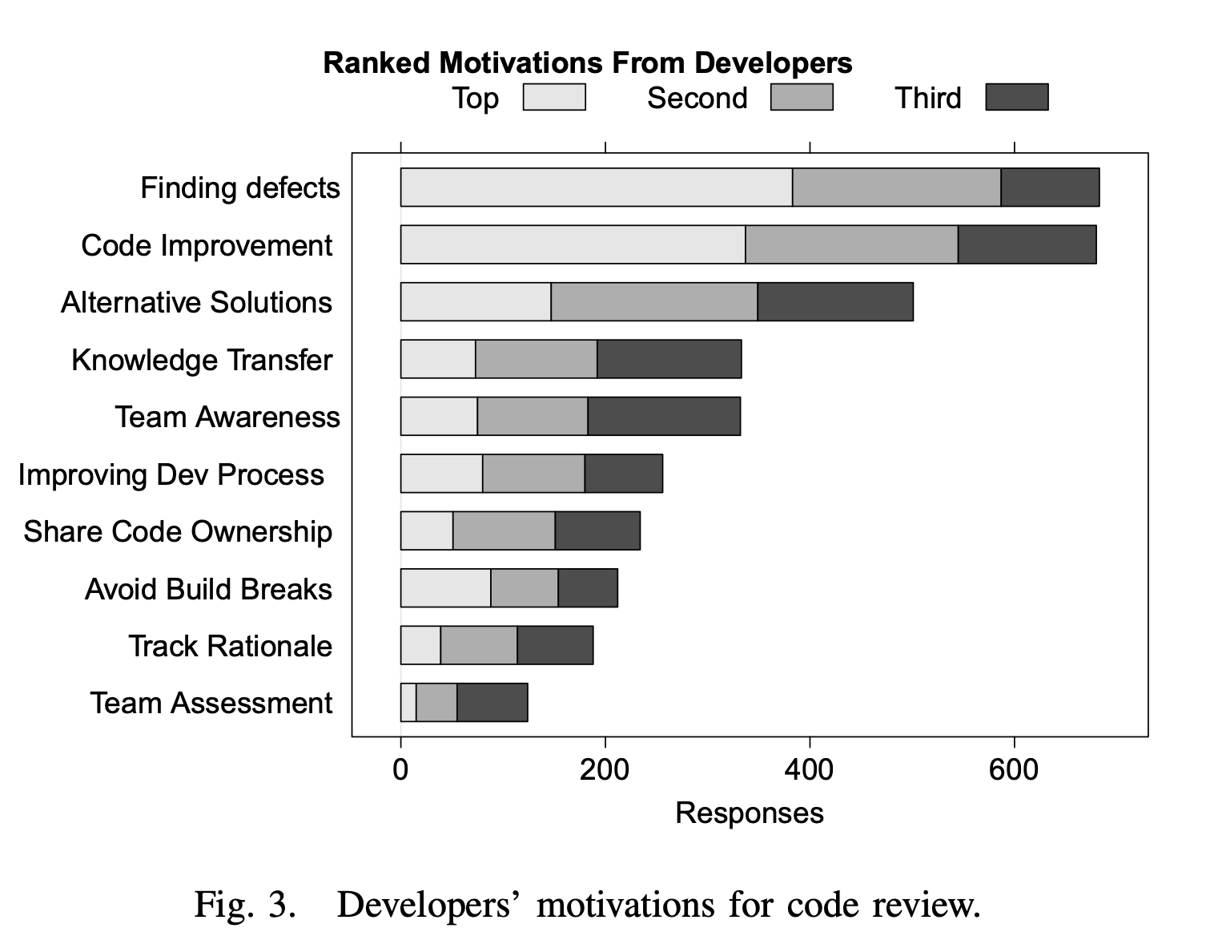
Why do we perform code reviews?
Survey internal to Microsoft
“Expectations, Outcomes, and Challenges of Modern Code Review”, Bacchelli & Bird, ICSE 2013
Notes:
Check code quality attributes that are hard to automatically check: security, compliance, scalability

Slide 16
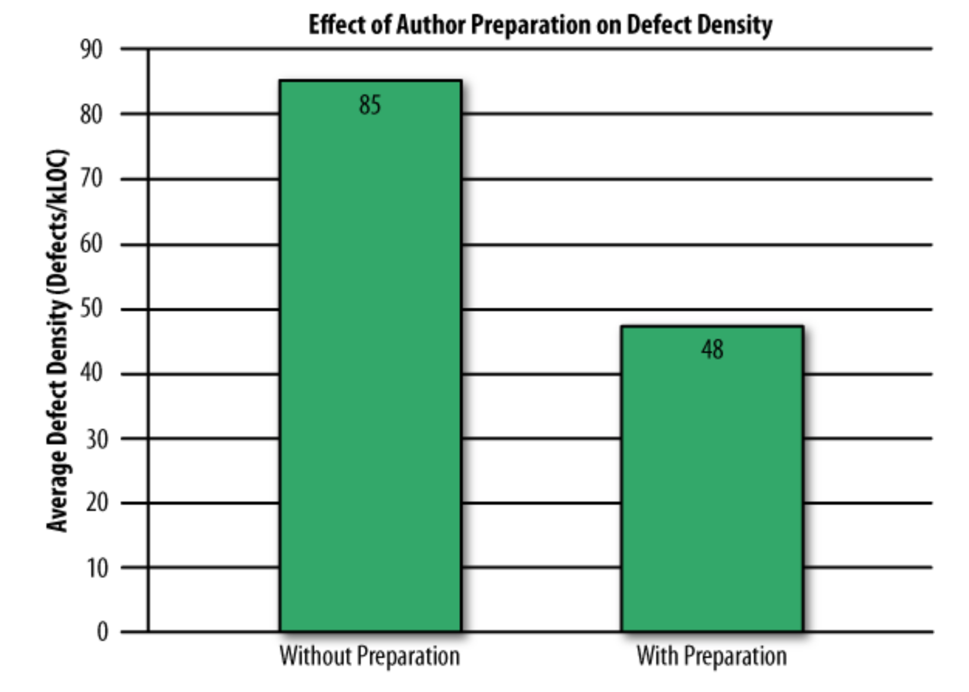
Studies show self-review is less effective
300 reviews at Cisco in 2006
Even if developers pre-review their code, many defects still found in peer review
“Best Kept Secrets of Peer Code Review”, Jason Cohen, SmartBear Software, 2006
Notes:
Ad hoc review
Passaround

Slide 17
How do we perform code reviews?
Who reviews what?
Don’t review your own code
Ideal: reviewer has different background, different experience
Come in with no preconceived idea of “correctness”
Don’t be biased by “what was intended”

Slide 18
Code Review: Proposed Patch
“Prevents more than 5 users from joining the room”
xport async function roomJoinHandler(requestData: TownJoinRequest): Promise<ResponseEnvelope<TownJoinResponse>> {
const room = CoveyRoom.findInstance(requestData.coveyTownID);
if (!room) {
return {
isOK: false,
message: 'Error: No such room',
};
}
const newPlayer = new Player(requestData.userName);
const newSession = await room.registerPlayer(newPlayer);
assert(newSession.videoToken);
if (room.occupancy > 5) {
return {
isOK: false,
message: 'The room is full!',
};
}
return {
isOK: true,
response: {
coveyUserID: newPlayer.id,
coveySessionToken: newSession.sessionToken,
providerVideoToken: newSession.videoToken,
currentPlayers: room.getPlayers(), // TODO check
friendlyName: room.friendlyName,
isPubliclyListed: room.isPubliclyListed,
},
};

Slide 19
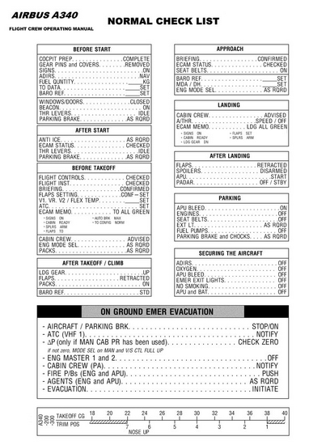
How do we perform code reviews?
What are we looking for?
More on checklists: https://www.newyorker.com/magazine/2007/12/10/the-checklist

Slide 20
Code review checklists
Some common ideas to get your checklist started
Am I able to understand the code easily?
Does the code follow our style guidelines?
Is the same code duplicated more than once?
Does this code meet our non-functional requirements?
Is this code maintainable? Does it have tests?
Does this code have unintended side-effects?
Can include issues previously detected in the past

Slide 21
Code Review: Proposed Patch
“Prevents more than 5 users from joining the room”
it('Does not allow more than 5 users to join a room', async () => {
const newRoom = await apiClient.createRoom({isPubliclyListed: true, friendlyName: 'test'});
const promisesShouldBeAccepted = [];
for (let i = 0; i < 5; i += 1) {
promisesShouldBeAccepted.push(apiClient.joinRoom({userName: 'test', coveyTownID: newRoom.coveyTownID}));
}
await Promise.all(promisesShouldBeAccepted);
});
Notes:
Bad things with this test:
5 is hardcoded
Does not check occupancy indicator, which was the original bug!

Slide 22
Code Review: Proposed Patch
“Prevents more than 5 users from joining the room”
it('Does not allow more than maximum users to join a room', async () => {
const newRoom = await apiClient.createRoom({isPubliclyListed: true, friendlyName: 'test'});
const rooms = await apiClient.listRooms();
const createdRoomInfo = rooms.towns.find(room => room.coveyTownID === newRoom.coveyTownID);
assert(createdRoomInfo);
const promisesShouldBeAccepted = [];
for (let i = 0; i < createdRoomInfo.maximumOccupancy; i += 1) {
promisesShouldBeAccepted.push(apiClient.joinRoom({userName: 'test', coveyTownID: newRoom.coveyTownID}));
}
await Promise.all(promisesShouldBeAccepted);
await expect(apiClient
.joinRoom({coveyTownID: newRoom.coveyTownID, userName: 'test'}))
.rejects.toThrowError();
});
Notes:
Bad things with this test:
5 is hardcoded
Does not check occupancy indicator, which was the original bug!

Slide 23
Code Review: Proposed Patch
“Prevents more than 5 users from joining the room”
it('Does not allow more than maximum users to join a room', async () => {
const newRoom = await apiClient.createRoom({isPubliclyListed: true, friendlyName: 'test'});
const rooms = await apiClient.listRooms();
const createdRoomInfo = rooms.towns.find(room => room.coveyTownID === newRoom.coveyTownID);
assert(createdRoomInfo);
const promisesShouldBeAccepted = [];
for (let i = 0; i < createdRoomInfo.maximumOccupancy; i += 1) {
promisesShouldBeAccepted.push(apiClient.joinRoom({userName: 'test', coveyTownID: newRoom.coveyTownID}));
}
await Promise.all(promisesShouldBeAccepted);
await expect(apiClient
.joinRoom({coveyTownID: newRoom.coveyTownID, userName: 'test'}))
.rejects.toThrowError();
// Now list rooms
const roomsAfterJoining = await apiClient.listRooms();
const updatedRoomInfo = roomsAfterJoining.towns.find(r => r.coveyTownID === newRoom.coveyTownID);
assert(updatedRoomInfo);
expect(updatedRoomInfo.currentOccupancy).toBeLessThanOrEqual(updatedRoomInfo.maximumOccupancy);
});
Notes:
This test is much better. It’s still possible that there are weird race conditions to get over the capacity, but this is pretty well tested, I think…

Slide 24
When do we perform code reviews?
In modern development environments (large OSS + companies)
For every change that gets merged upstream!
If you are asked to review something, you must do it soon (but don’t interrupt current task)
Include the entire context of a change, not just a diff
Google’s entire process is publicly documented: https://google.github.io/eng-practices/review/
Notes:
Per google: If you are not in the middle of a focused task, you should do a code review shortly after it comes in.
One business day is the maximum time it should take to respond to a code review request (i.e. first thing the next morning).

Slide 25
This work is licensed under a Creative Commons Attribution-ShareAlike license
This work is licensed under the Creative Commons Attribution-ShareAlike 4.0 International License. To view a copy of this license, visit http://creativecommons.org/licenses/by-sa/4.0/
You are free to:
Share — copy and redistribute the material in any medium or format
Adapt — remix, transform, and build upon the material
for any purpose, even commercially.
Under the following terms:
Attribution — You must give appropriate credit, provide a link to the license, and indicate if changes were made. You may do so in any reasonable manner, but not in any way that suggests the licensor endorses you or your use.
ShareAlike — If you remix, transform, or build upon the material, you must distribute your contributions under the same license as the original.
No additional restrictions — You may not apply legal terms or technological measures that legally restrict others from doing anything the license permits.

